Slide 1
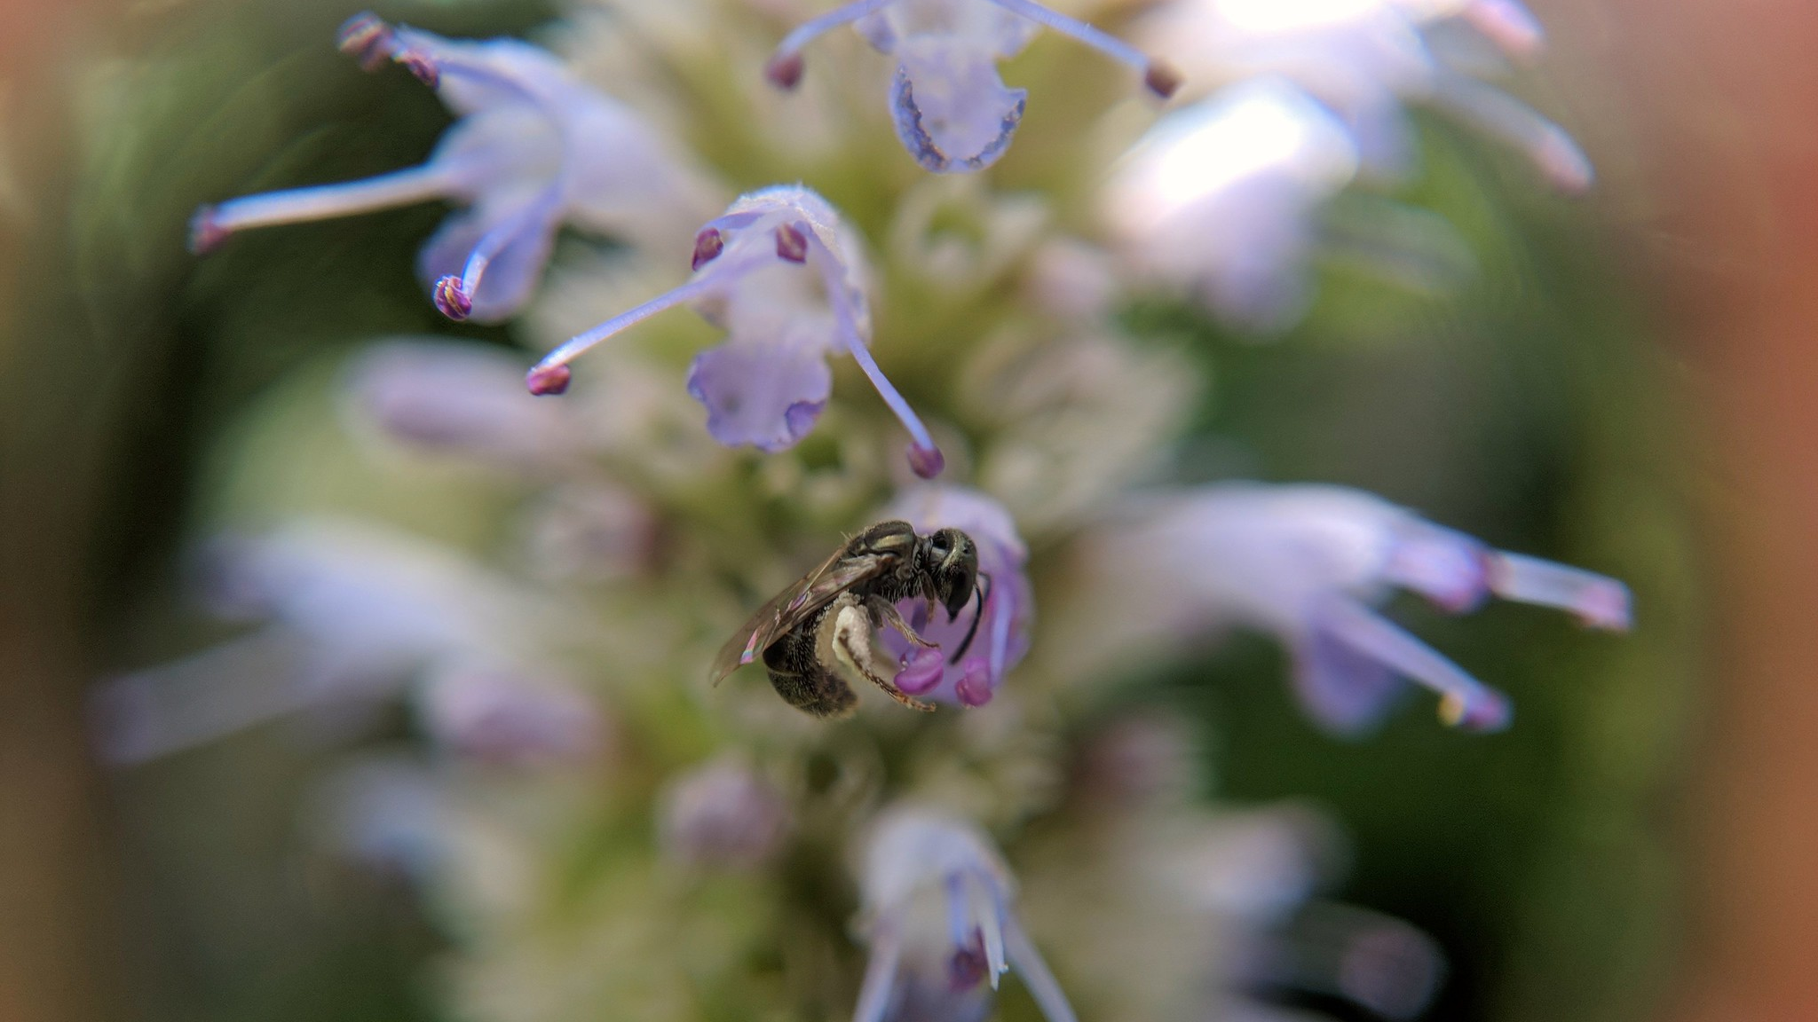
Producing impactful research
12/3/2019
http://bit.ly/strongerscience
Image © Jon Fisher
Notes:
Image from https://www.flickr.com/photos/jaundicedferret/29388341328/

Slide 2
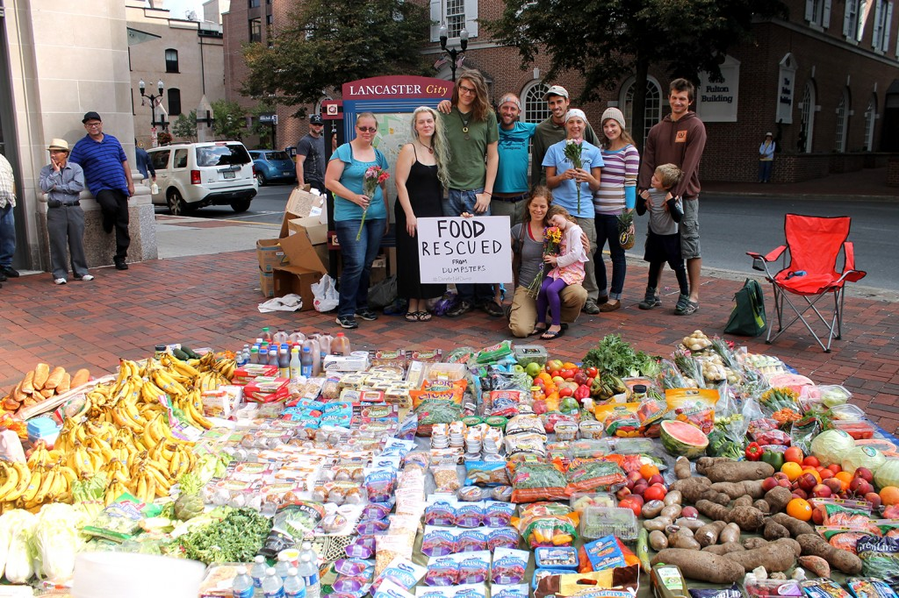
The problem
Image © Rob Greenfield, robgreenfield.tv
Notes:
Is anything more heartbreaking than seeing something wasted that someone else desperately needs?
For example, we waste $165 billion in food annually
https://www.washingtonpost.com/news/wonk/wp/2012/08/22/how-food-actually-gets-wasted-in-the-united-states/?utm_term=.fb2ce808c095
Photo from Lancaster PA: http://robgreenfield.tv/foodwaste/

Slide 3
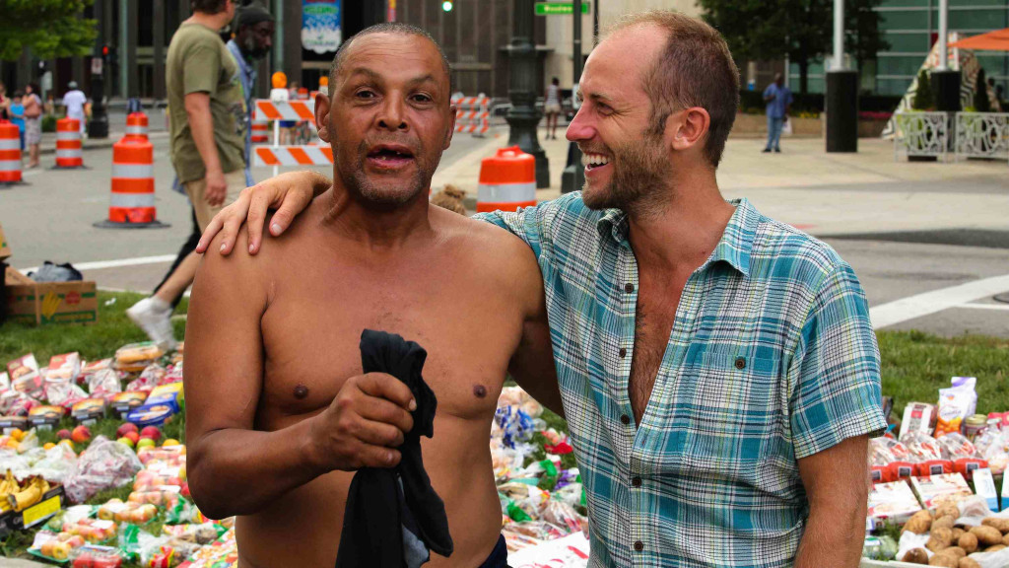
The problem
Image © Rob Greenfield, robgreenfield.tv
Notes:
While 40 million Americans are food insecure –
https://www.feedingamerica.org/hunger-in-america/facts
This is a photo of David in Manhattan: http://robgreenfield.tv/foodwaste/

Slide 4
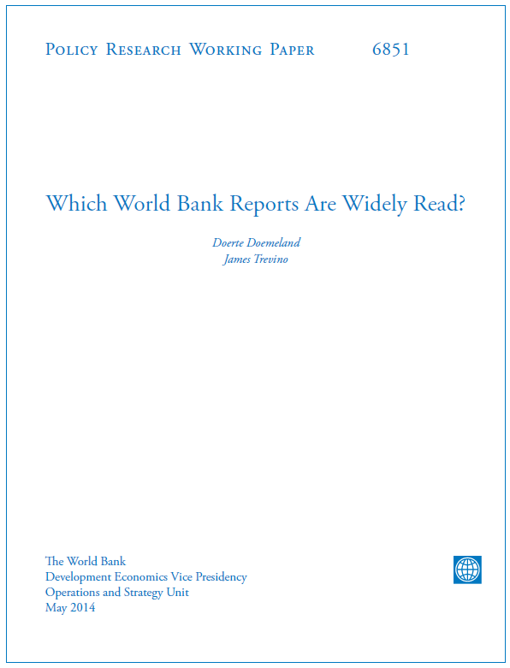
The problem
Notes:
Research is often unused (whether by design or not) –World Bank analysis in 2014 (32% of articles never downloaded, 87% never cited), research articles

Slide 5
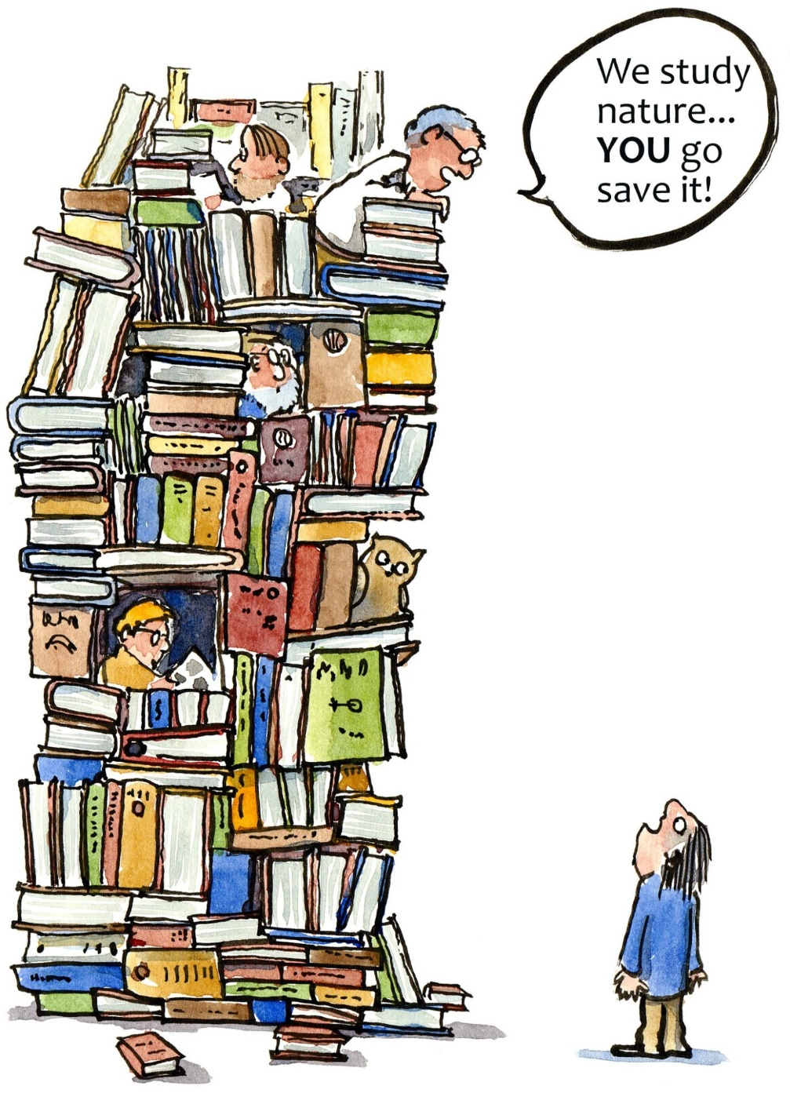
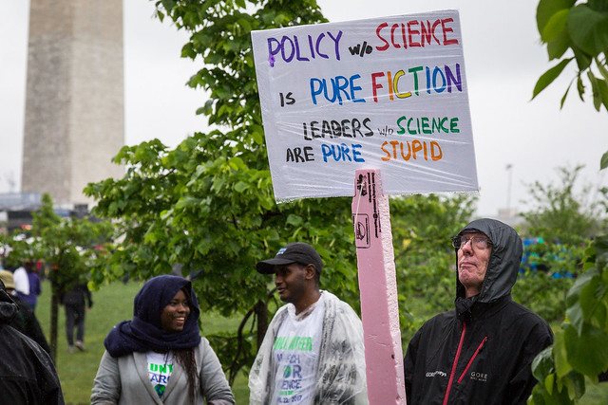
The problem
Image © Frits Ahlefeldt
Image © Mobilus In Mobili
Notes:
Here are two unfair stereotypes of why – ivory tower scientists vs. willfully ignorant decision makers
Researchers may be worried about dumbing down science, about balancing independence and rigor w/ relevance and advocacy, or lack the skills to have more impact
Conversely decision makers may be unaware of science, lack access to it, not understand it, or view it as irrelevant (e.g. wrong science, or public consensus > evidence)
The reality is that most decision makers want to use the best evidence, and most conservation scientists want to have more impact via research (although they can have impact other ways, focus here is research)
I’ve been on both sides and wished for better guidance – it’s hard to quickly find actionable science, and to produce useful science
Images from https://fritsahlefeldt.com/2011/09/22/academic-avoid-reality/ and https://www.flickr.com/photos/mobili/34099834221
References:
World bank reports: https://slate.com/news-and-politics/2014/05/world-bank-reports-unread-policy-recommendations-go-undiscovered.html
Research article use: https://www.smithsonianmag.com/smart-news/half-academic-studies-are-never-read-more-three-people-180950222/
Public consensus vs. science: White, E. M., Lindberg, K., Davis, E. J., & Spies, T. A. (2019). Use of Science and Modeling by Practitioners in Landscape-Scale Management Decisions. Journal of Forestry, 117(3), 267–279. https://doi.org/10.1093/jofore/fvz007

Slide 6
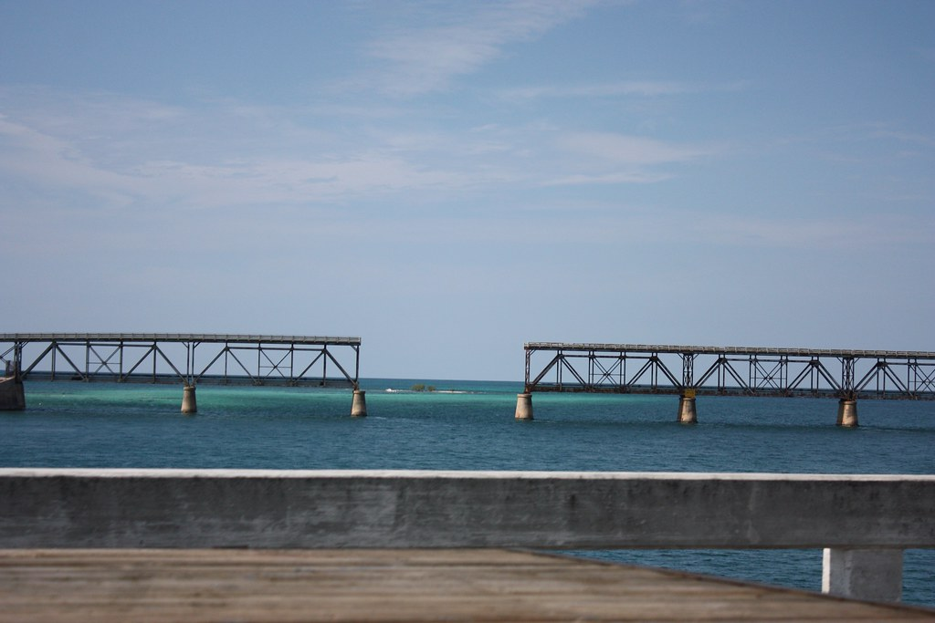
How to bridge the gap
Image © Ewen Roberts
Notes:
Few how-to guides to bridge that gap and make research more relevant, and most (although not all) that exist require grounding in the lit
~10 people thinking through were winnowed down to 4 who stuck with it over ~ 1 year (me, Steve Wood, Mark Bradford, Rodd Kelsey)
>20 people (including 2 non-scientists) reviewed drafts of the paper and gave us input
Image from https://www.flickr.com/photos/donabelandewen/3584154214

Slide 7
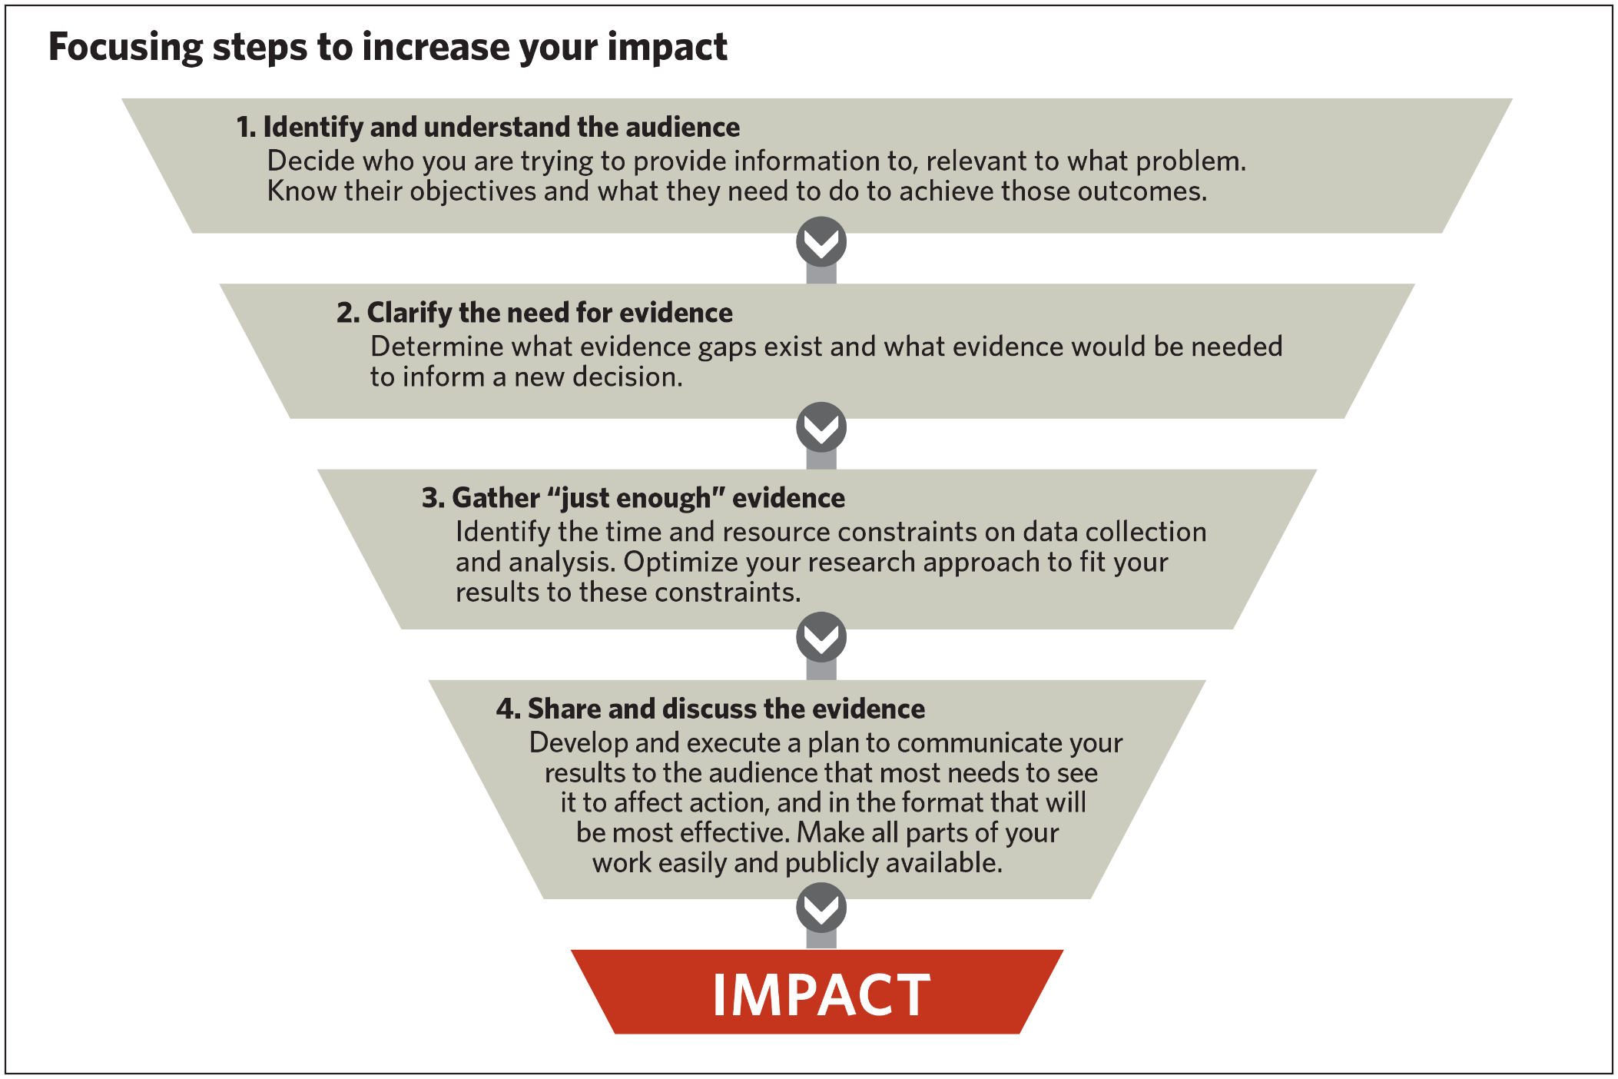
Recommendations
Notes:
We make four key recommendations, and for each, in the paper we explain why it’s important & how to do it
Guidelines, NOT a strict recipe for success, and not easy to do

Slide 8
ID & Understand the Audience (Partners)
Identify the specific audience you want to inform
Engage in the community of practice you seek to influence
Work with them to identify and clarify a priority problem of mutual interest
Notes:
Note – more like partners than audience, language is imprecise and hard to get right. Plug translational or transdisciplinary approach, co-develop research.

Slide 9
Clarify the Need for Evidence
What actions are being considered? What scales?
Does the audience see an evidence gap? Why?
Will new evidence suffice to drive action?
Translate potential actions into research questions
Notes:
Temporal and spatial scales. How will they choose action(s) to take? Policy context? Respect legitimacy of decision making process (e.g. evidence v consensus)
Partner w/ audience on developing the right research questions

Slide 10
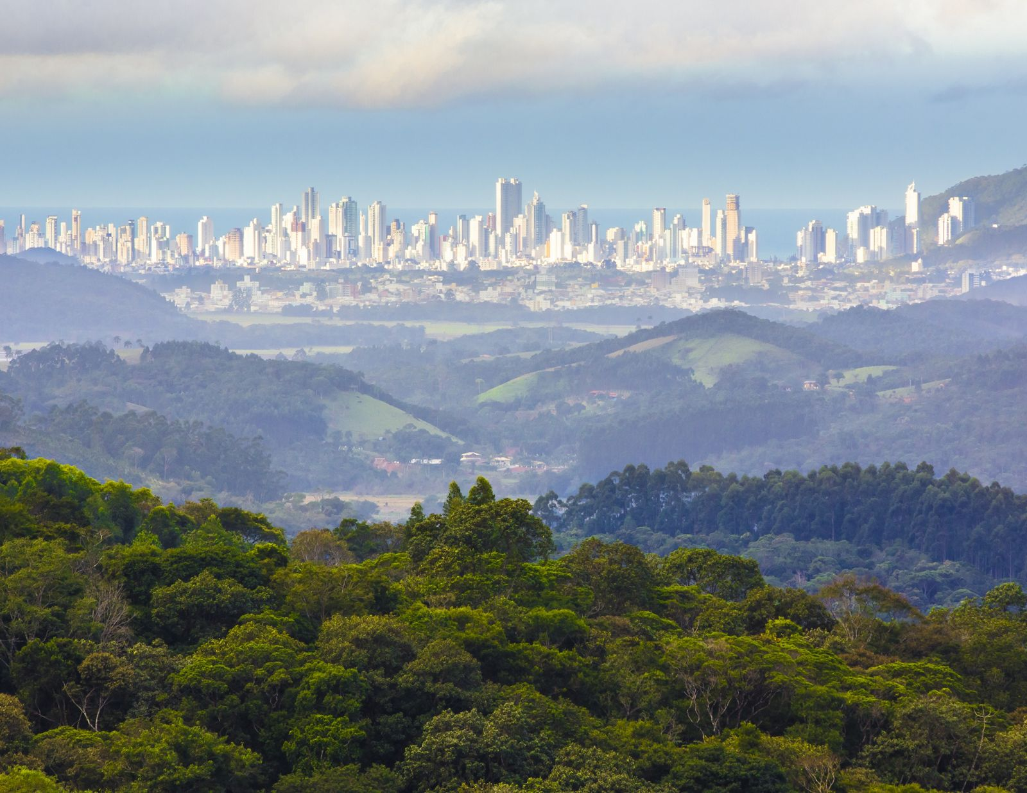
Gather “just enough” evidence – background story
Image © Andre Targa Cavassani/The Nature Conservancy
Notes:
Photo from https://www.nature.org/en-us/what-we-do/our-insights/perspectives/how-to-assess-the-return-on-investment-in-watershed-conservation/

Slide 11
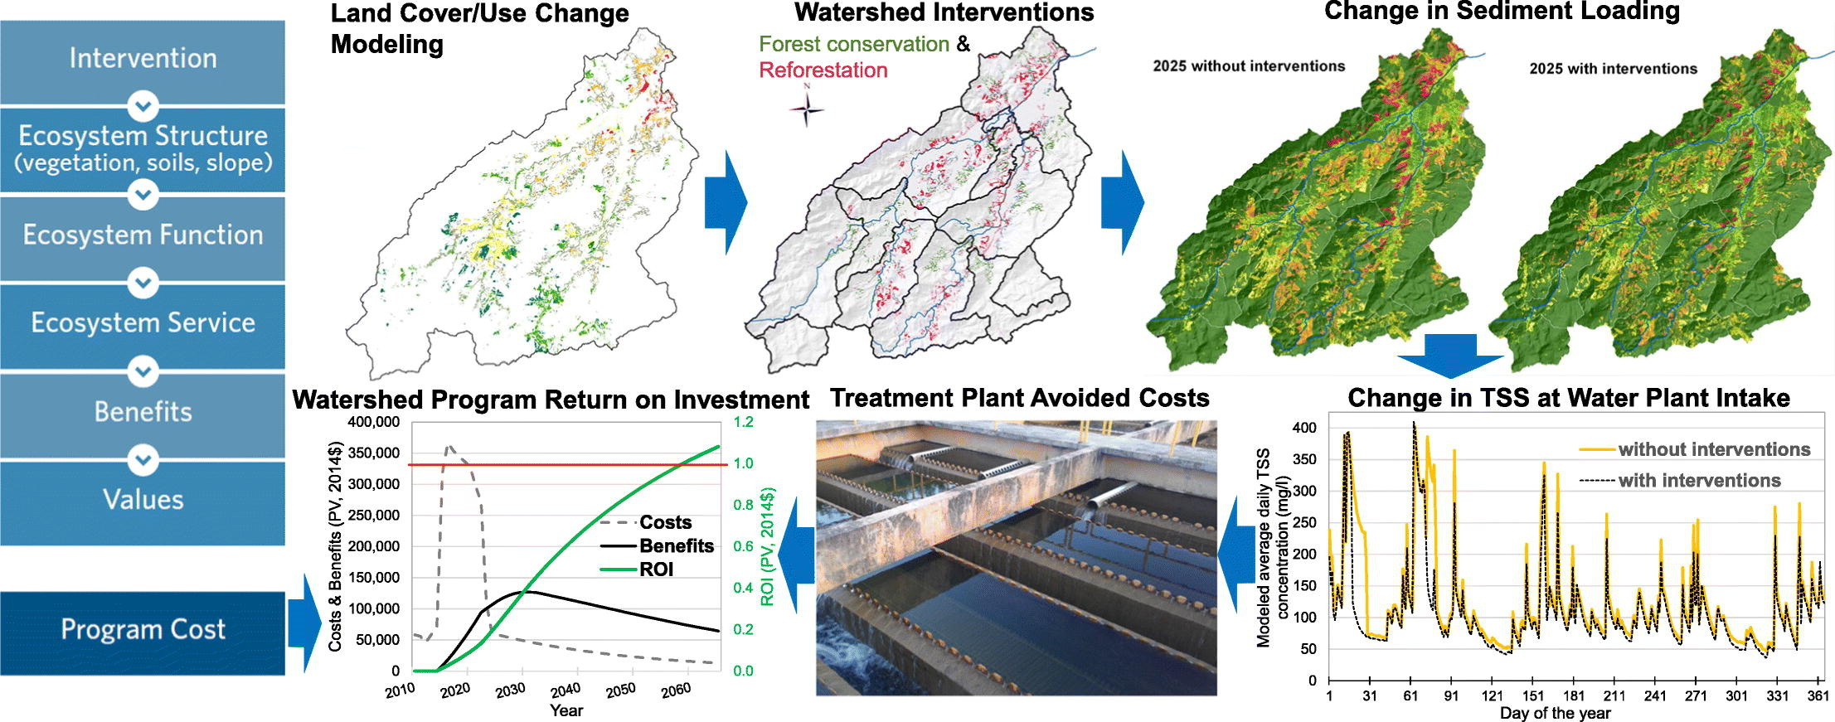
Gather “just enough” evidence – background story
Kroeger et al. 2019, https://linkinghub.elsevier.com/retrieve/pii/S0048969718349611

Slide 12
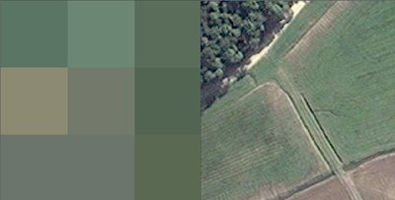
Gather “just enough” evidence – background story
Images © Jon Fisher

Slide 13
Gather “just enough” evidence – background story
Notes:
28% of the watershed area had a different classification (pasture vs rice, forest vs plantation, changes due to pixel size / shape, etc.)

Slide 14
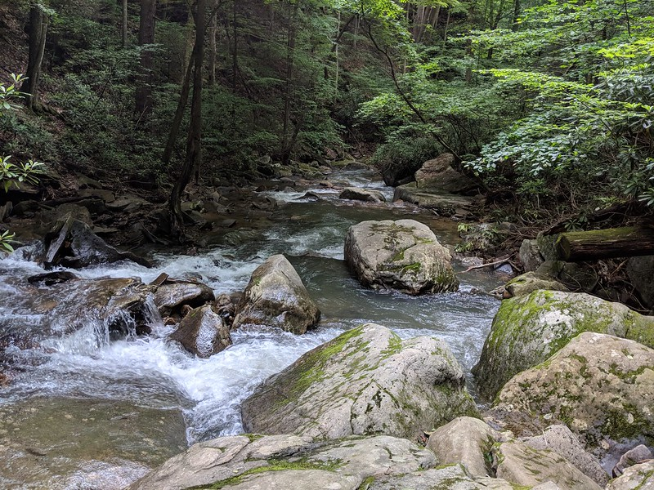
Gather “just enough” evidence – background story
VS
Image © Jon Fisher
Image © U.S. EPA
Notes:
EPA photo from https://www.flickr.com/photos/usepagov/15011059300

Slide 15
Gather “just enough” evidence
Understand the type of data your audience needs
Evaluate the potential for adaptive management
Tailor the type of evidence to the value of information & timeline
Notes:
Tell water fund story to make this one real
Data type could be: quant vs qual, general vs site-specific, precise vs ordinal

Slide 16
Share & discuss the evidence
Create a communications plan early
Develop a clear, compelling message
Improve your communication skills
Share summaries, paper, all data & code with the public
…
Notes:
This doesn’t include all steps we recommend.
Audience key to develop and test msg
Comms skills both written and oral

Slide 17
Caveats
Authors are not representative of audience
This is really hard to do, requires help
Not a comprehensive look at this topic
Guidelines, not a recipe, results not guaranteed (need luck & persistence)
Notes:
Authors are all white male scientists (some also practitioners) living in America so our perspective is likely limited. We didn’t follow our own advice and work hard enough to retain decision makers and others in our product
That shows this is hard – full time experts (in policy, comms, boundary spanning) can help a lot – you don’t need to be a science superhero
For non-comprehensive: length limits reduced both breadth and depth, but we know some substantial areas are missing or only covered very lightly (e.g. knowledge co-production), and didn’t want to just link to a bunch of other work w/o having space to talk about what it means and why it matters.
Finally these are guidelines to consider, not a linear recipe that has to be followed exactly. And some (e.g. Cairney & Oliver 2018) think these kinds of guides are impractical and unhelpful

Slide 18
Discussion & Resources
Discussion
How does this align with your experience?
What’s missing or wrong?
How might this be more useful?
Resources:
Preprint: http://bit.ly/strongerscience
Email: jfisher@pewtrusts.org
Twitter @sciencejon
Notes:
The preprint has the full paper this talk is based on, and includes references to the few similar papers we have found. It is under review at a journal now.

Slide 19
Outline (paper)
1. Identify and understand your audience
Identify the specific, potential audience(s) you want to inform
Work with your target audience(s) to identify and clarify the problem(s) they are trying to solve
Engage in the community of practice you are trying to influence
2. Clarify the need for evidence
Identify if the audience thinks there is an evidence gap (and why)
Identify actions the decision-maker is considering
Determine if new evidence will be enough to drive action
Translate actions being considered into research questions
3 Gather “just enough” evidence
Understand the type of data your audience needs
Tailor the type of evidence to the value of information
Evaluate the potential for adaptive management
Make and execute a work plan that meets the hard deadline for a decision to be made
4. Share and discuss the evidence
Develop a clear, compelling message
Document relevance and caveats associated with the evidence
Create a communications plan as part of the research design
Meet with your audience(s) face-to-face
Improve your writing
Remove barriers to access
Publish accessible summaries of your work
Share all data and code, not just statistically significant findings
Notes:
Outline

